Slide 1
An Analysis of Lego Dataset

Slide 2
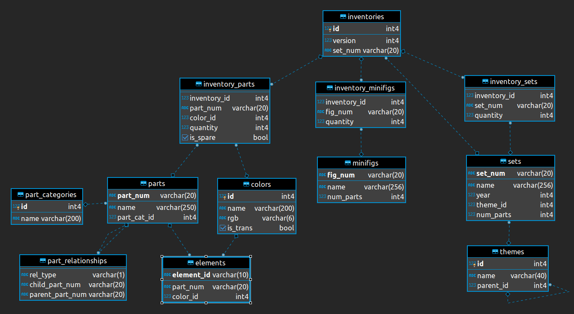
The structure of the dataset “Lego”

Slide 3
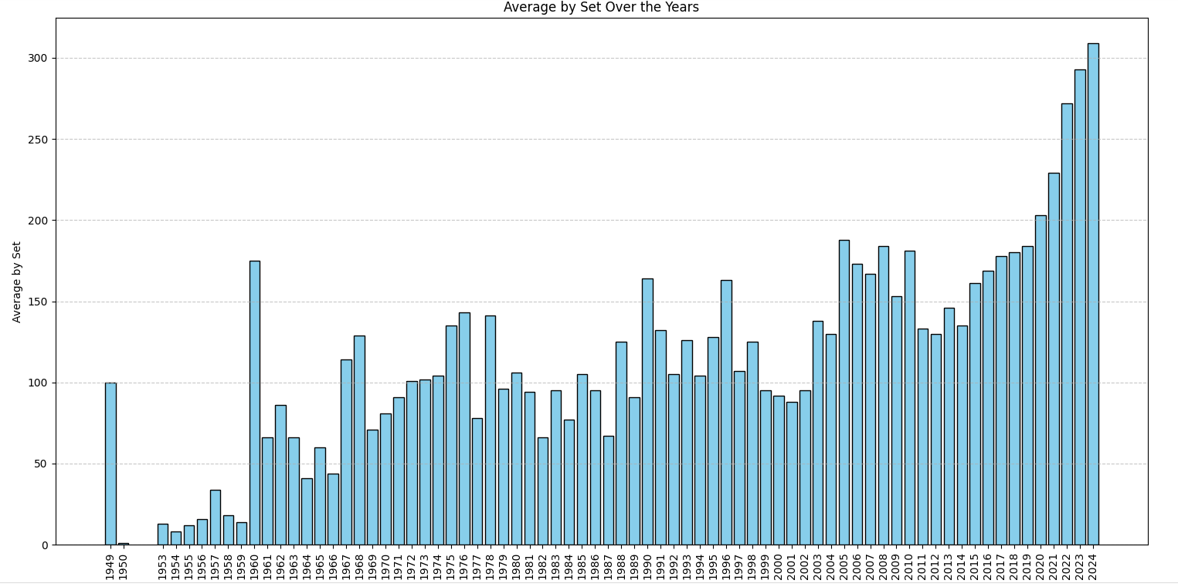
Question: What is the overall trend in average set values from 1949 to 2024?
SELECT
year,
round(AVG(num_parts)) AS averagebyset
FROM
`lego-june2024.lego_dataset.sets`
GROUP BY
year

Slide 4
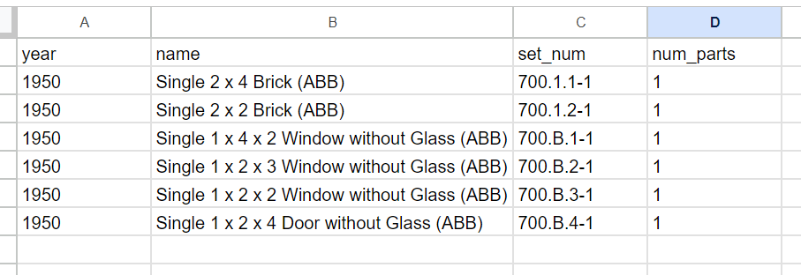
Which year had the lowest average set values and why?
Select
year,name, set_num, num_parts
FROM `lego-june2024.lego_dataset.sets`
WHERE year = 1950

Slide 5
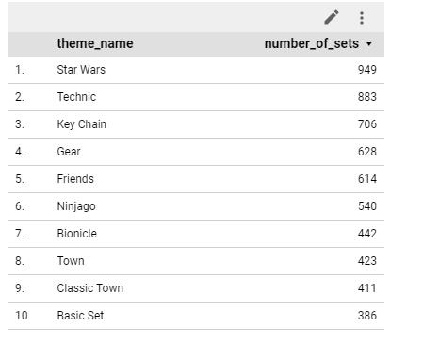

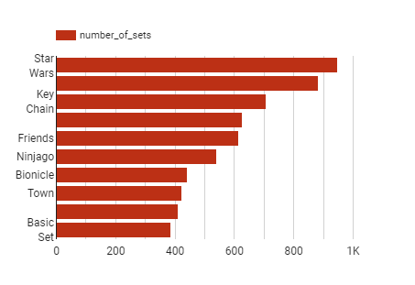
Diversity of Themes Over Time
SELECT
t.name AS theme_name,
COUNT(s.set_num) AS number_of_sets
FROM
`lego-june2024.lego_dataset.sets` s
JOIN
`lego-june2024.lego_dataset.themes` t
ON
s.theme_id = t.id
GROUP BY
theme_name
ORDER BY
number_of_sets DESC
LIMIT 10;

Slide 6
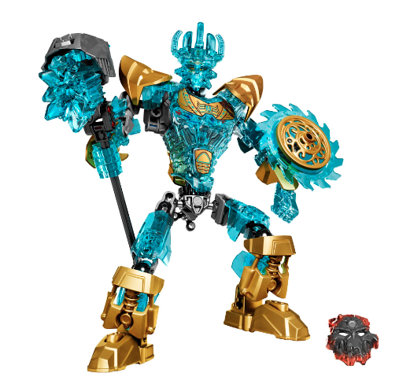
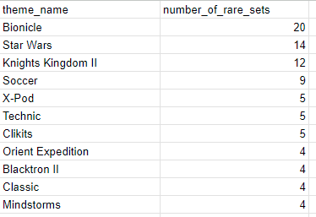
We also can see the distribution of rare LEGO parts across different themes
WITH RareParts AS (
SELECT
part_num,
COUNT(DISTINCT inventory_id) AS set_count
FROM
`lego-june2024.lego_dataset.inventory_parts`
GROUP BY
part_num
HAVING
set_count < 10
)
SELECT
t.name AS theme_name,
COUNT(DISTINCT s.set_num) AS number_of_rare_sets
FROM
`lego-june2024.lego_dataset.sets` s
JOIN
`lego-june2024.lego_dataset.inventory_sets` inv_set
ON
s.set_num = inv_set.set_num
JOIN
`lego-june2024.lego_dataset.inventory_parts` ip
ON
inv_set.inventory_id = ip.inventory_id
JOIN
RareParts rp
ON
ip.part_num = rp.part_num
JOIN
`lego-june2024.lego_dataset.themes` t
ON
s.theme_id = t.id
GROUP BY
t.name
ORDER BY
number_of_rare_sets DESC;

Slide 7
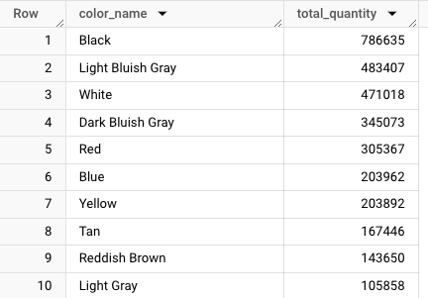
What is the most popular color of lego in terms of parts produced
SELECT color_name, SUM(quantity) AS total_quantity
FROM (
SELECT
ip.color_id,
ip.inventory_id,
ip.part_num,
CAST(ip.quantity AS numeric) AS quantity,
ip.is_spare,
c.name AS color_name,
c.rgb,
p.name AS part_name,
p.part_material,
pc.name AS category_name
FROM redi-demo.Rebrickable.inventory_parts ip
INNER JOIN redi-demo.Rebrickable.colors c ON ip.color_id = c.id
INNER JOIN redi-demo.Rebrickable.parts p ON ip.part_num = p.part_num
INNER JOIN redi-demo.Rebrickable.part_categories pc ON p.part_cat_id = pc.id
) AS inventories
GROUP BY inventories.color_name
ORDER BY total_quantity DESC
LIMIT 10

Slide 8
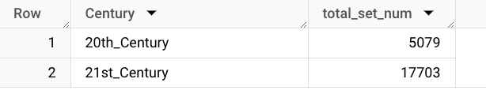
How many sets were created in each century?
SELECT
Century,
COUNT(set_num) AS total_set_num
FROM
(
SELECT
s.set_num,
CASE
WHEN s.year BETWEEN 1901 AND 2000 THEN '20th_Century'
WHEN s.year BETWEEN 2001 AND 2100 THEN '21st_Century'
END AS Century
FROM
redi-demo.Rebrickable.sets s
) AS sets_by_century
GROUP BY
Century;

